Slide 1
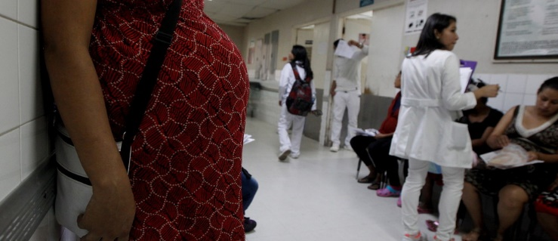
Modeling Maternal Mortality Rates (MMR)
Data Science Part Time Course
Rebecca Minich
11.29.16
Notes:
https://assets.weforum.org/article/image/large_b05pCeiWDULOlBGVxJ52gFYvy6EPYx8R5WyOhPz1lNQ.jpg

Slide 2
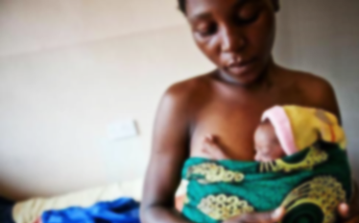
What factors contribute to global MMR?
PROBLEM STATEMENT:
Can I predict which socioeconomic and public health initiatives will improve global and national maternal mortality rates?
Notes:
Numerous sociopolitical factors contribute, you can see this at play with the individual states in the US. In regions with high MMRs,

Slide 3
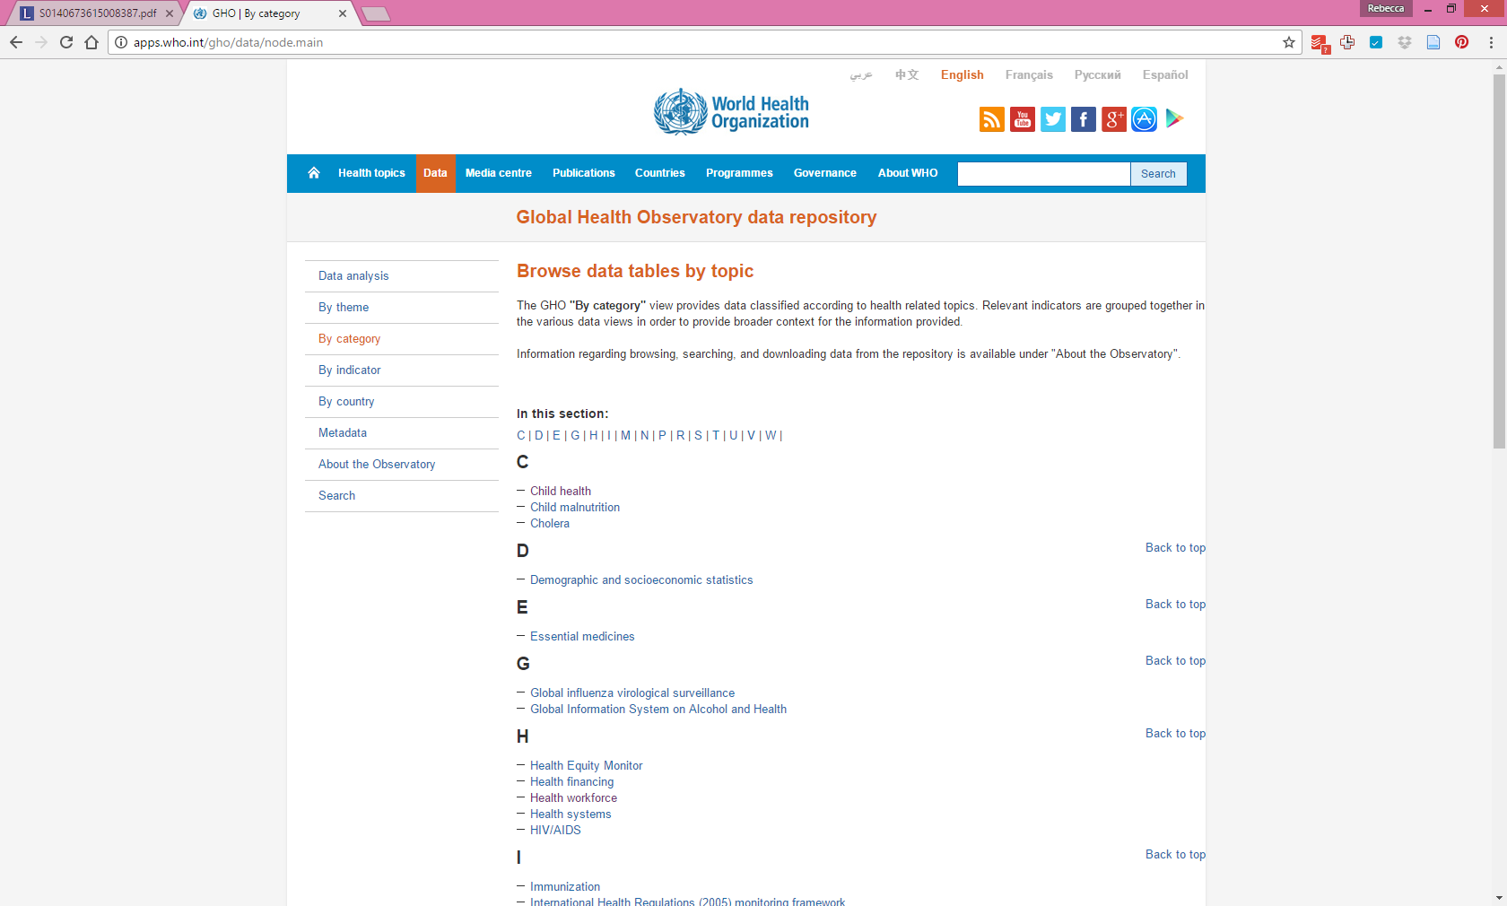

Could other factors contribute to MMR?
Datasets
Maternal Mortality Rates (MMR):
Birth attendant
Antenatal (prenatal) care
Adolescent Birth Rates
Contraceptives modern methods
Abortion policy scale
Education: Primary School Enrollment
Technology: Cellphone Subscribers
War: Homicides
Health: Life Expectancy
Wealth: GNI Per Capita Data by Country(PPP)
Notes:
Main data sources for HDI data - Column 1: HDRO calculations based on data from UNDESA (2015), UNESCO Institute for Statistics (2015), United Nations Statistics Division (2015), World Bank (2015a), Barro and Lee (2014) and IMF (2015). Column 2: UNDESA (2015). Column 3: UNESCO Institute for Statistics (2015). Column 4: UNESCO Institute for Statistics (2015), Barro and Lee (2014), UNICEF Multiple Indicator Cluster Surveys and ICF Macro Demographic and Health Surveys. Column 5: World Bank (2015a), IMF (2015) and United Nations Statistics Division (2015). Column 6: Calculated based on data in columns 1 and 5.

Slide 4
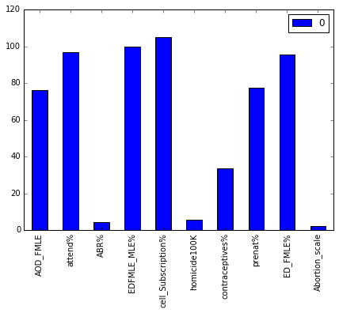
Dataframe and Features
190 countries
12 different datasets, 33 columns
Response variable: Maternal Mortality Rate
Features and median values:

Slide 5
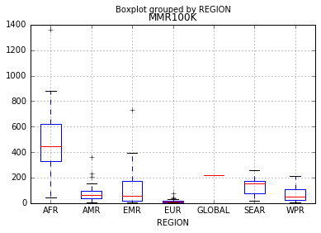
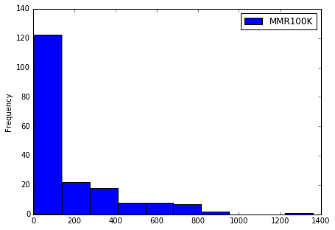
Response Variable
Regional MMR
MMR Frequency
MMR100K - Maternal deaths per 100,000 births
MMRClassifier - Created for logistic regression model based on min, max and 25, 50, 75% of MMR.
MMRBinary - Binary variable for logistic regression model.

Slide 6
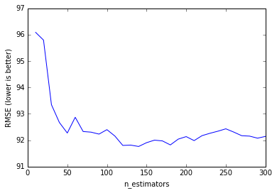
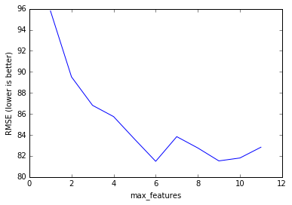
Optimizing Features:
Random Forest Regressor
Estimator Tuning
Feature Tuning
140
6
RMSE for all demographics (CV=5, estimators=140): 91.88
RMSE for optimized features (CV=10, estimartors=130): 82.65

Slide 7
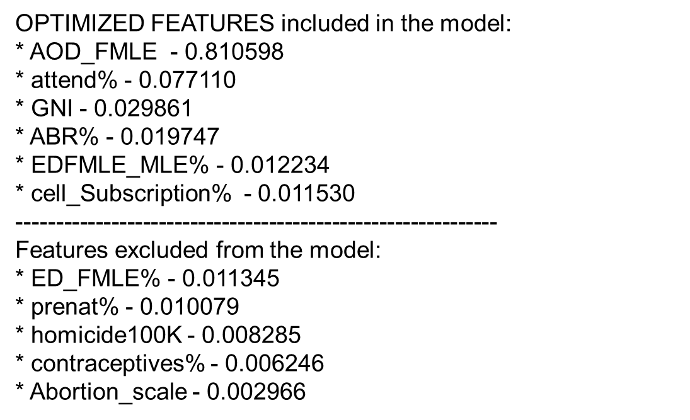
Conclusions
Demographic contributions to model:
Successful hypothesis: Education
Surprising outcomes: Abortion policy, cell phone subscriptions
Future Work
Build a model that lacks well known causal demographics and determine the predictability.
Add more demographics, here are some potential data sets to improve the model from WHO.
Notes:
Although the social burdens alone make this an important public health issue, there is also a steep economic cost HL in the form of disability, loss of days worked and the cost of devices to improve hearing. To better understand the progression of AHL I am going to describe mammalian auditory transduction

Slide 8
Model Comparisons
Selection of demographics: 'ABR%', 'AOD_FMLE', 'GNI', 'EDFMLE_MLE%', 'cell_Subscription%', 'attend%'.
Maternal Mortality Rates (MMR):
All of the models were able to improve null accuracy.
The random forest classifier model performs better than the logistic regression model.
Reducing the number of demographics improves model accuracy in most cases.
Note: The random forest regressor model is the only model run that produces rate predictions.

Slide 9
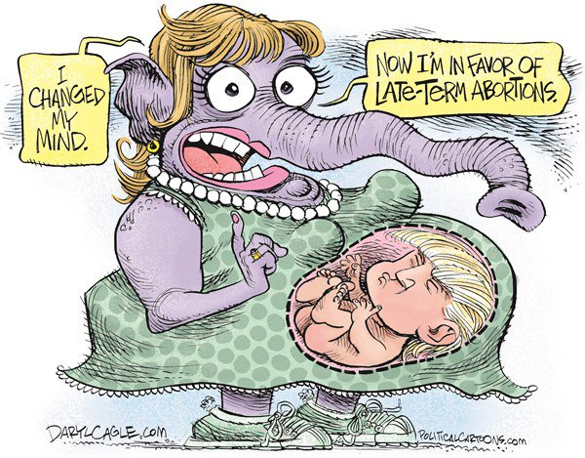
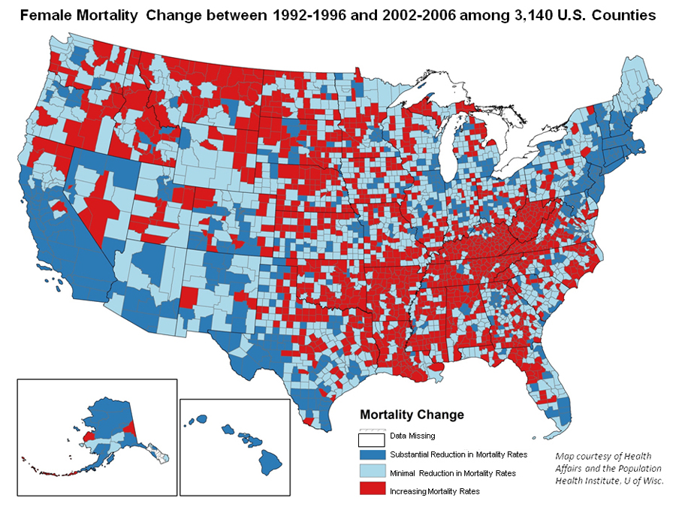
Pet Project
“I bet the Republican Party wishes there was a way to have a late-term abortion for their presidential nominee”
Notes:
Although the social burdens alone make this an important public health issue, there is also a steep economic cost HL in the form of disability, loss of days worked and the cost of devices to improve hearing. To better understand the progression of AHL I am going to describe mammalian auditory transduction

Slide 10
Which areas of the data have you cleaned, and which areas still need cleaning?
API Work
CSV
WHO: Uses XML,
attempting to convert to json Currently succeeded in creating df out of MMR and Adolescent BR
UN: Uses SOAP
Haven’t even tried it yet
CFRR: PDF factsheets Put data into CSV by hand
CFRR: Created a scale from 0-6 for access to safe abortions by UN country
WHO and UN: created Pandas.df that includes HDI and MMR info.
Cleaning: Indexed on Countries, found redundant country values and flattened, IDed missing values in pd.df
Notes:
Although the social burdens alone make this an important public health issue, there is also a steep economic cost HL in the form of disability, loss of days worked and the cost of devices to improve hearing. To better understand the progression of AHL I am going to describe mammalian auditory transduction

Slide 11
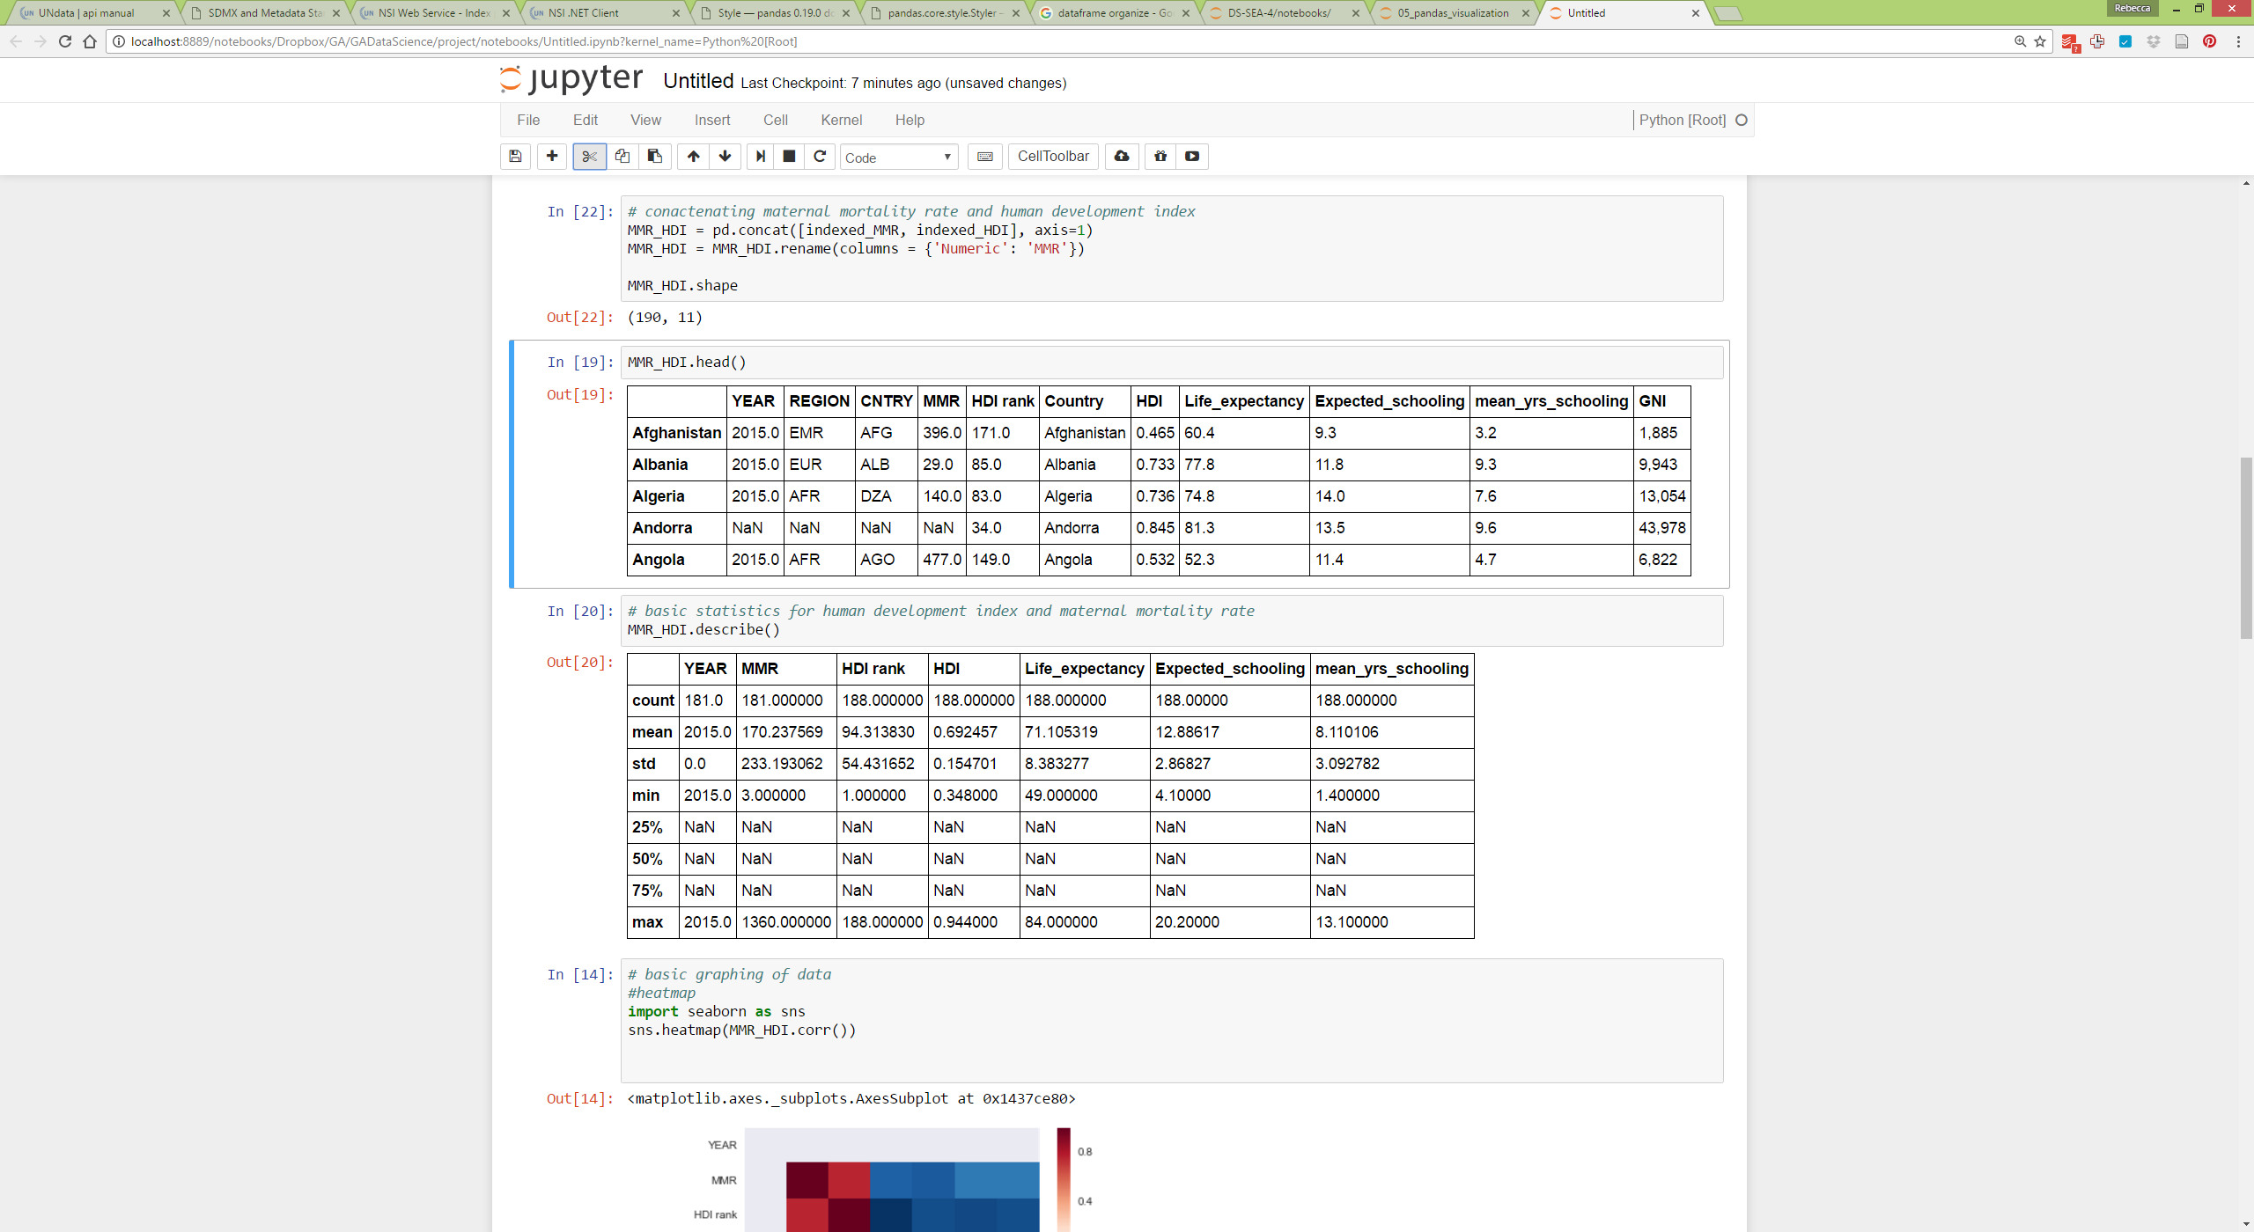
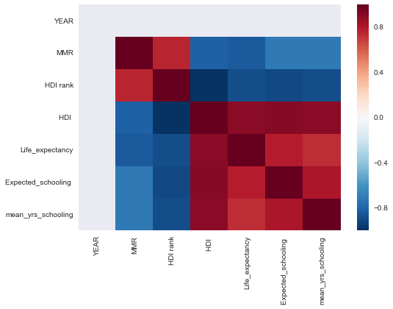
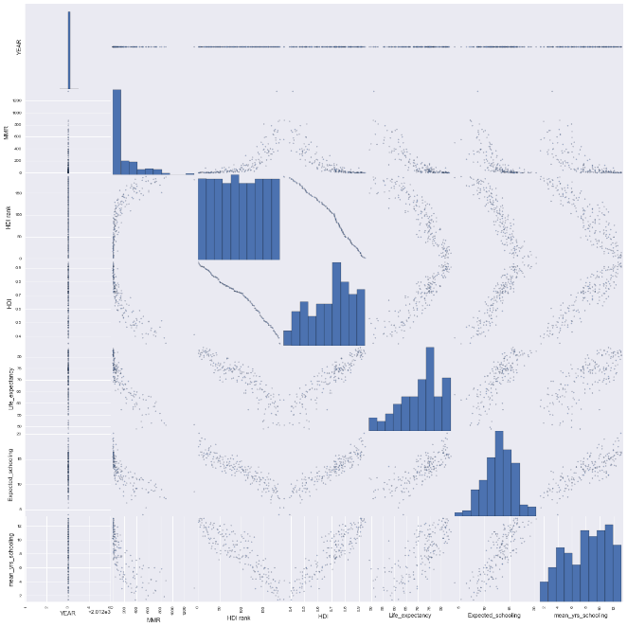
What steps have you taken to explore the data?
CSV
Notes:
Although the social burdens alone make this an important public health issue, there is also a steep economic cost HL in the form of disability, loss of days worked and the cost of devices to improve hearing. To better understand the progression of AHL I am going to describe mammalian auditory transduction

Slide 12
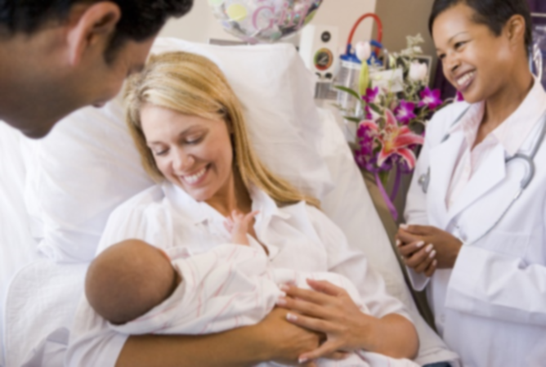
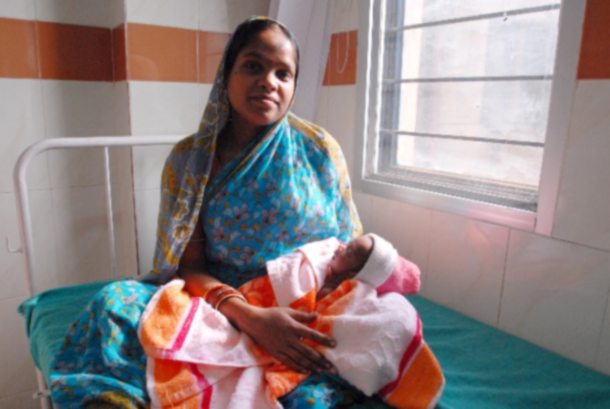
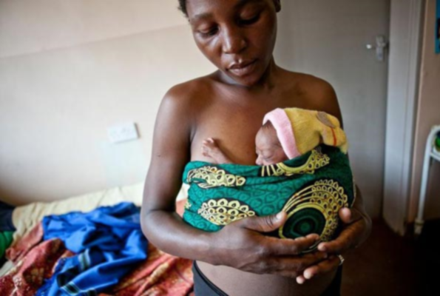
The Problem
Finland: 3
India: 174
Sierra Leone: 1360
Notes:
Median MMR was 54 deaths per 100k live births.
Min: Finland w/ 3
Max: Sierra Leone w/ 1360
CURRENT: MMR of 216 per 100k
GOAL: Global MMR of 70 per 100k by 2030
Western mom - https://www.oakbendmedcenter.org/wp-content/uploads/2015/04/bigstock-New-Parents-With-Baby-Talking-4637025.jpg
Western mom - http://www.affordabledaycare.net/stk25210nwl.jpg
Orissa mom - https://upload.wikimedia.org/wikipedia/commons/c/c7/Mother_and_newborn_child_in_Orissa.jpg
East Africa mom - http://healthreportereastafrica.com/wp-content/uploads/2016/01/premature-babies-ug.jpg
Worldmapper - http://www.worldmapper.org/display.php?selected=258

Slide 13
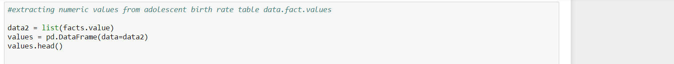
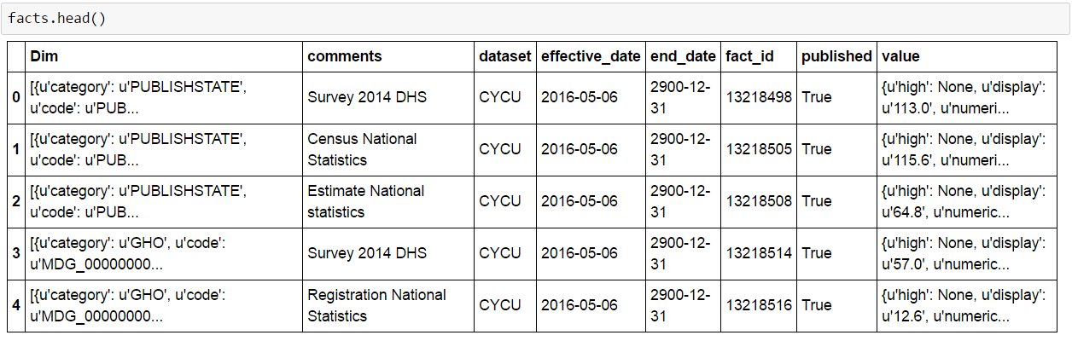
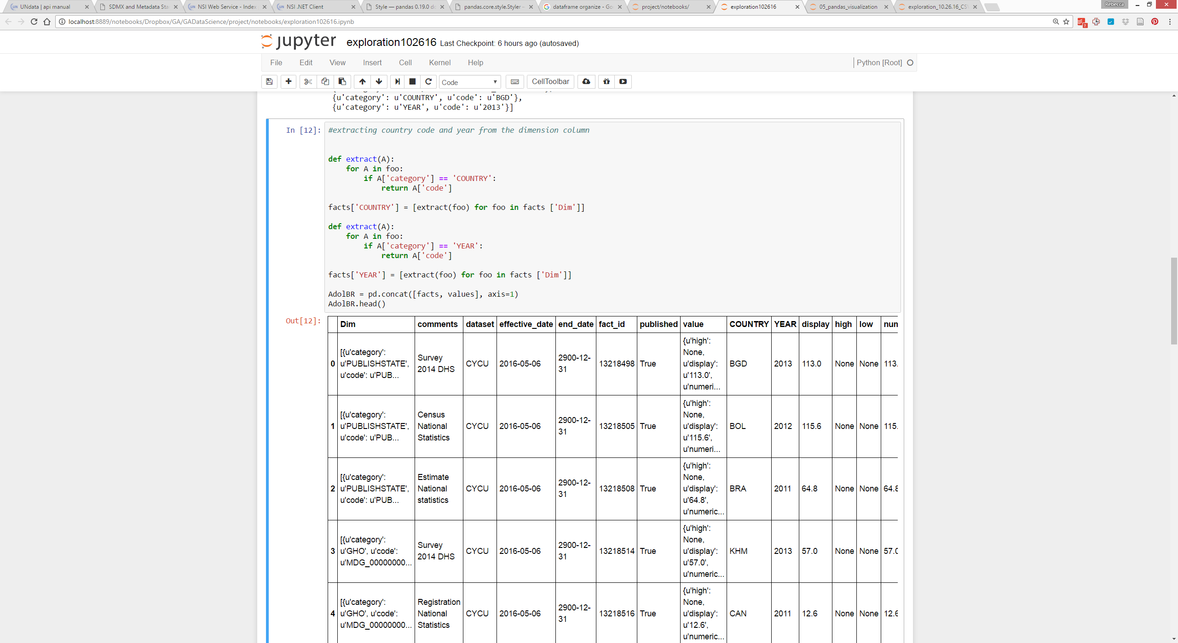
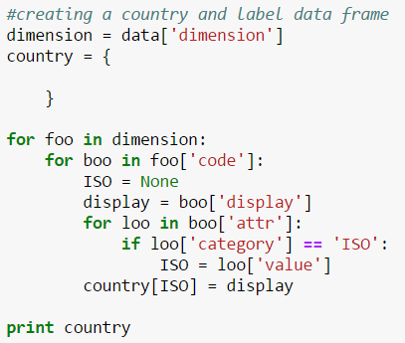
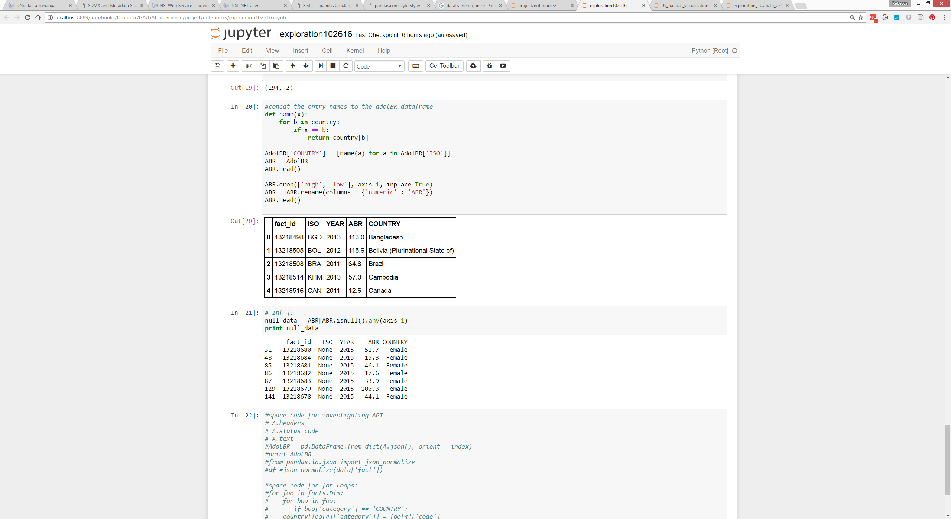
CLEANING WHO API
1
3
4
2

